Slide 1



CLASSIFICATION OF SIGNIFICANT WATER RESOURCES AND DETERMINATION OF RESOURCE QUALITY OBJECTIVES FOR WATER RESOURCES IN THE USUTU TO MHLATHUZE CATCHMENTS (WP11387):
BACKGROUND
INCEPTION MEETING
Presented by:
Mnisi Mkhevu
Department: Water & Sanitation
Date: 11 February 2022

Slide 2
Legal Mandate
Chapter 3 of the National Water Act, (No. 36 of 1998) deals with the protection of water resources
The Resource-Directed Measures for protection of water resources are:
  Classification (S13)
  Reserve (S16)
  Resource Quality Objectives (S13)
S12 requires the Minister to establish the Water Resource Classification System, (WRCS)
WRCS was published as Regulation 810 in Government Gazette No. 33541 dated 17 September 2010
The WRCS defines:
  water resource classes and
  the procedure to determine Class, RQOs and Reserve
According to the NWA, once the WRCS has been gazetted all significant water resources must be classified

Slide 3
Background
30 Months project: running from December 2021 to May 2024
The aim of the project is to determine:
  - Water Resource Classes
  Resource Quality Objectives in the Usutu to Mhlathuze catchments

Slide 4
Classification System
The WRCS provide guidelines and procedures for setting different MC (MCs) ;
MC describes what state the water resources need to be in to satisfy beneficial use;
MC facilitates the balance between protection and use of the water resources;
MC is defined by taking into account the social, economic & ecological landscape;
Process requires co-operation & transparency with all stakeholders.

Slide 5
Classification Process
Step 1: Delineate the Integrated units of analysis and describe the status quo of the water resources
Step 2: Link the socio-economic and ecological value and condition of the water resources
Step 3: Quantify the ecological water requirements and changes in non-water quality ecosystem goods, services and attributes
Step 4: Determine an ecologically sustainable base configuration (ESBC) scenarios
Step 5: Evaluate scenarios within the integrated water resource management process
Step 6: Evaluate the scenarios with stakeholders
Step 7: Gazette and implement the class configuration.

Slide 6
Water Resource Classes
Classification defines the desired state of the water resources by setting Water Resource Classes;
Each class represents:
    a different level of protection that is required for the water resource, and
    the extent to which the water resource can be used.
Classification is used in two ways:
    To describe the present status of the water resource
    To describe the state towards which the water resource needs to be managed sustainably (future state).
Classes | Description of use | Ecological categories
Class I | Minimally used | A-B
Class II | Moderately used | C
Class III | Heavily used | D & lower
Ecological Category (EC) - means the assigned ecological condition to a water resource in terms of the deviation of its biophysical components from a pre-development condition.

Slide 7
Resource Quality Objectives (RQOs)
RQOs are numeric or descriptive statements of conditions which should be met in the receiving water resource;
RQOs represent the requirements for water quantity, quality, and habitat and biotic integrity to be maintained in aquatic ecosystems.
RQOs provide measurable goals that give direction as to how the resources need to be managed.

Slide 8
RQOs Determination Process
Step 1: Delineate the integrated units of analysis and define the resource units;
Step 2: Establish a vision for the catchment and integrated units of analysis;
Step 3: Prioritise and select preliminary resource units for RQO determination;
Step 4: Prioritise sub-components for RQO determination and select indicators for monitoring;
Step 5: Develop draft resource quality objectives and numerical limits;
Step 6: Agree on RQOs and numerical limits with stakeholders;
Step 7: Finalise and gazette RQOs.

Slide 9

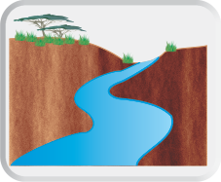
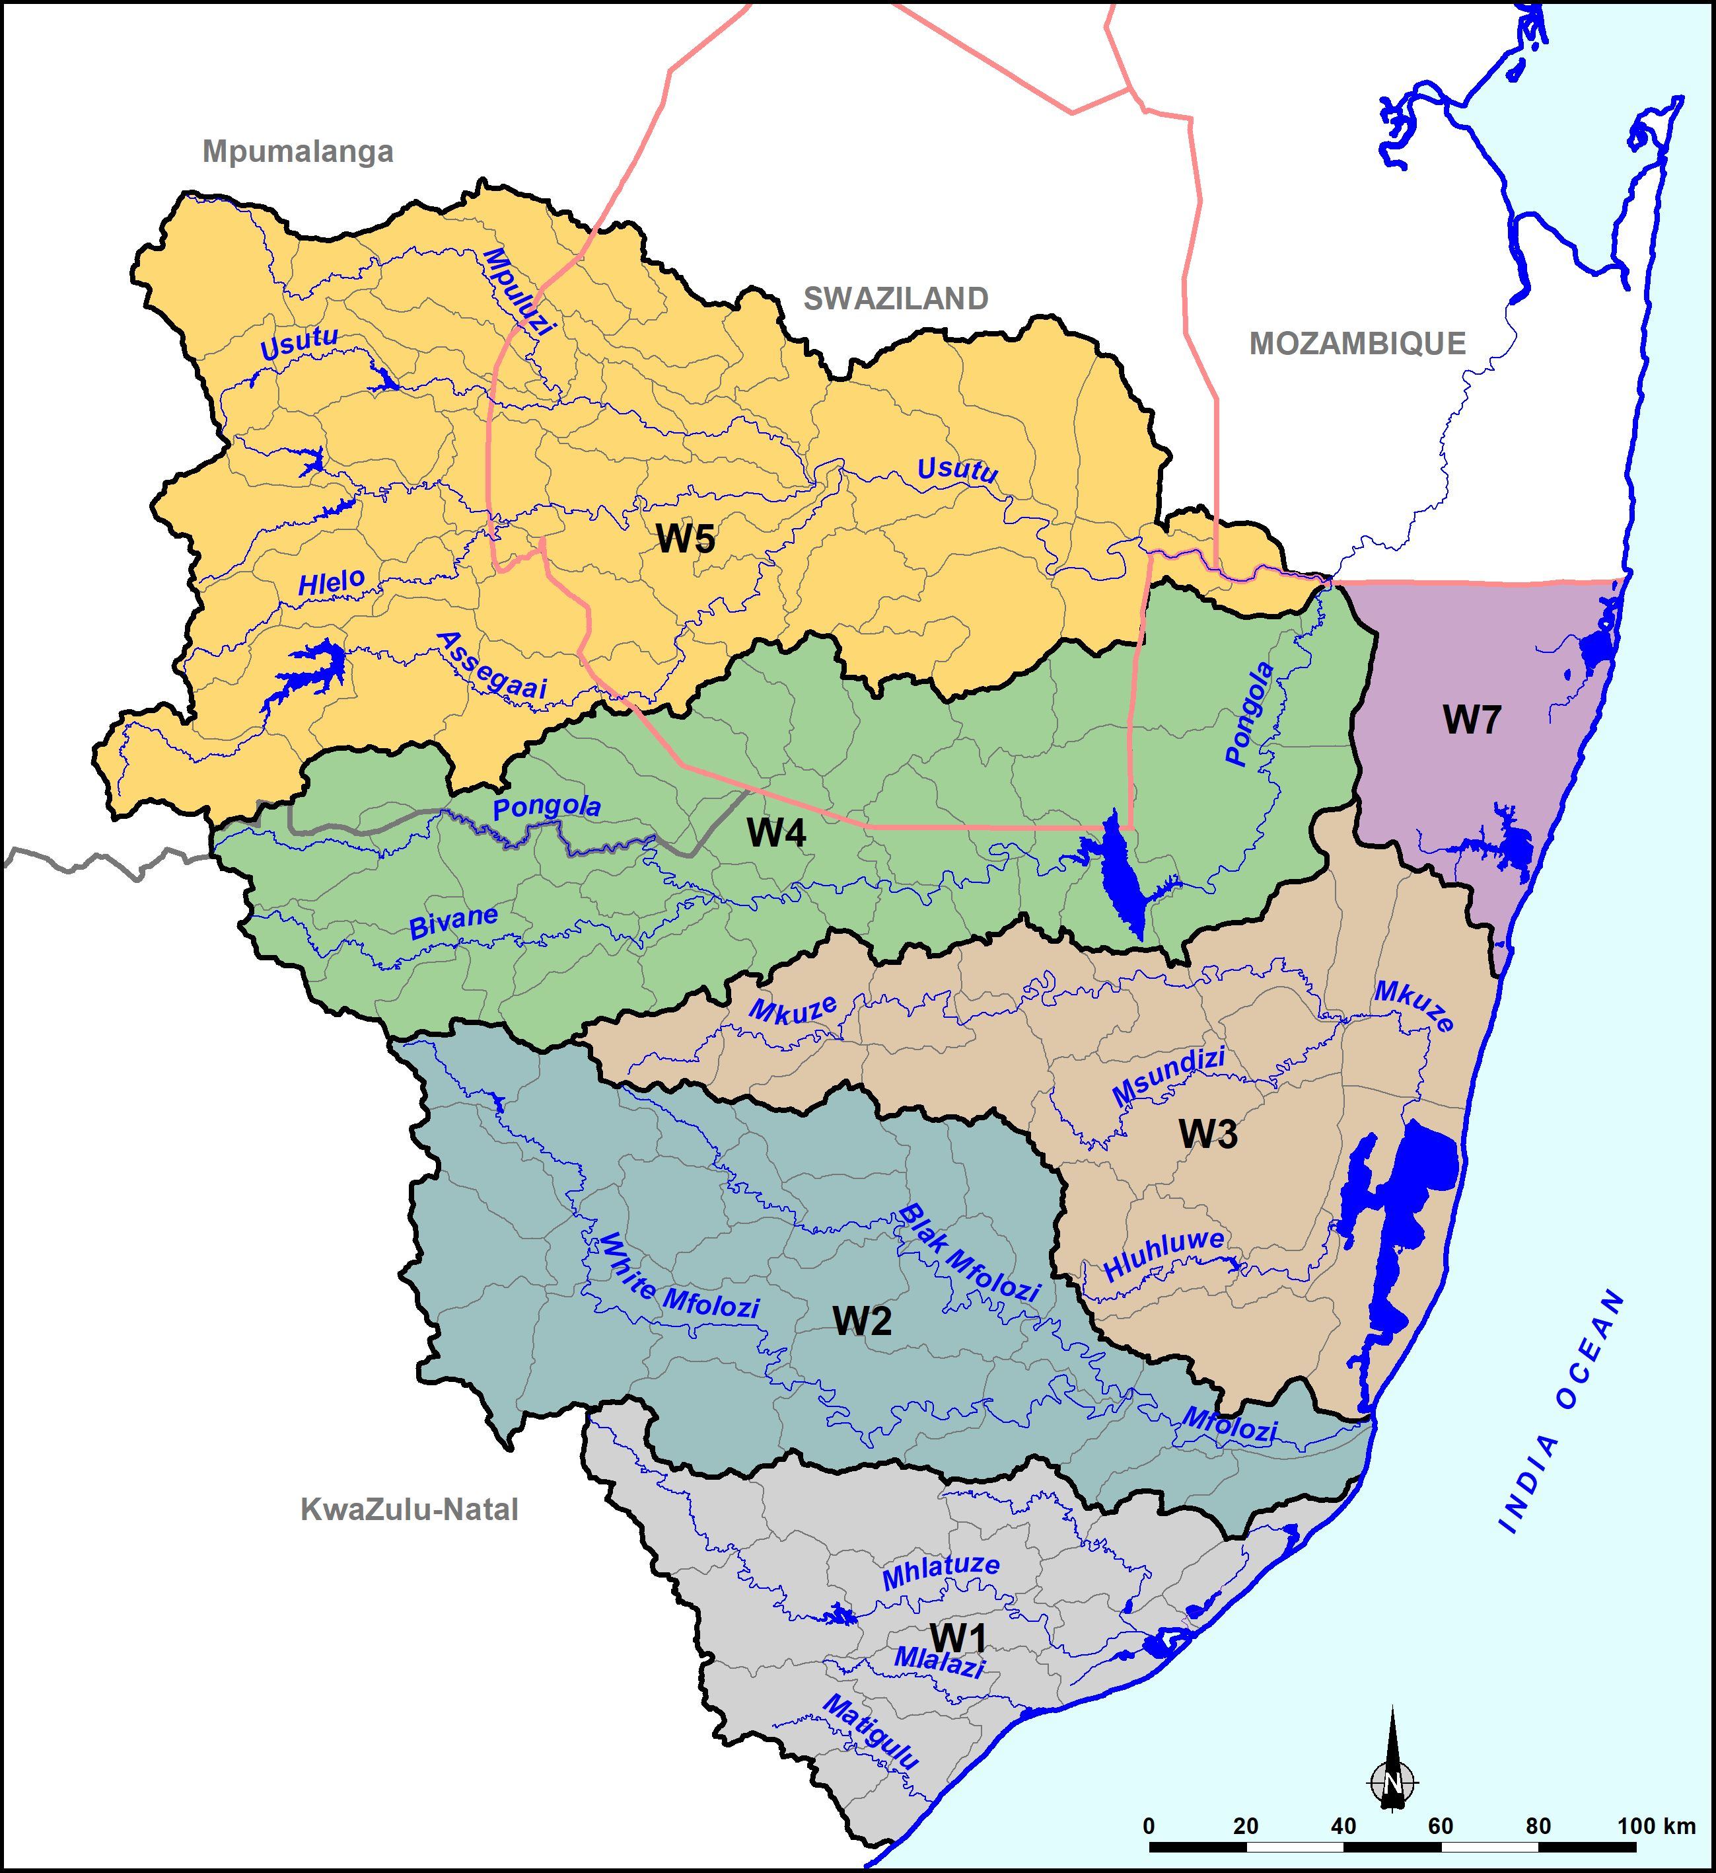
Example of Descriptive RQOs
Narrative RQOs: Representative for IUA
Nutrients: Instream concentration of nutrients must be maintained to sustain aquatic ecosystem health and ensure the prescribed ecological category is met.
Salts: In-stream concentrations of salt must be maintained or improved upon to support the aquatic ecosystem and the water quality user requirements.
Pathogens: The presence of pathogens should pose a low risk to human health.
System variables: pH must be maintained at present state.
Toxics: The concentrations of toxins should not be at a level that is toxic to aquatic organisms and human health.

Slide 10
Example of numerical RQO limits
E.coli ≤ 130 counts/100ml All RUs
NO₃ & NO₂-N ≤ 1.0 mg/l Orthophosphate as P ≤ 0.090 mg/l
Electrical conductivity ≤ 40 mS/m U/S Sulphate ≤ 15 mg/L. Sodium ≤ 10 mg/l Chloride ≤ 15 mg/l
pH range 6.5 – 8.5
Dissolved Oxygen ≥6 mg/L
Oil and Grease 2.5 mg/l
Toxics and Pesticides
2_2
NO₃+NO₂-N ≤ 0.5 mg/l Orthophosphate as P ≤ 0.020 mg/l
pH range 6.5 – 8.0
Electrical conductivity ≤ 30 mS/m. Sulphate ≤ 10 mg/L. Sodium ≤ 10 mg/l Chloride ≤ 10 mg/l
Turbidity - A 10% variation from background concentration should be allowed.
Atrazine | ≤0.078 milligrams/litre (mg/l)
Mancozeb | 0.009 milligrams/litre (mg/l)
Glyphosate | 0.7 milligrams/litre (mg/l)
Endosulfan | 0.13 micrograms/litre (ug/l)
2_1
Ammonia as N | ≤ 0.0725mg/l
Aluminium | ≤ 0.062 mg/l
Manganese | ≤ 0.37mg/l.
Iron | ≤ 0.1 mg/l.
Lead | ≤ 0.006mg/l
Copper | ≤ 0.0073mg/l
Nickel | ≤ 0.07mg/l
Orthophosphate as P ≤ 0.010mg/l. NO₃+NO₂-N ≤ 0.05 mg/l
Electrical conductivity ≤ 20 mS/m. Sulphate ≤10 mg/l Sodium ≤10 mg/l Chloride ≤ 10 mg/l
2_3

Slide 11
Study Area
The study area is the Usutu- Mhlatuze Catchments
Divided into 6 drainage areas/secondary catchments:
  Mhlatuze, W1
  Mfolozi, W2
  Mkuze/Hluhluwe, W3
  Pongola, W4
  Usutu, W5
  W7 catchment.

Slide 12
Map of the Study Area

Slide 13
Capacity Building
To ensure skills transfer to the DWS officials, the following are proposed
Workshops with DWS officials
Mentoring of DWS Water Resource Classification officials PSP to establish a Capacity Building programme aligned to skills developmental needs

Slide 14
Potential Areas for Capacity Building
Classification and RQOs determination process : Overview (Possibly May 2022)
2. Operational scenarios – selection, modelling and evaluation and Classes. (Possibly August 2023)
3. RQOs and gazetting (Possibly December 2023)

Slide 15
Stakeholder Engagement
  Identified Platforms: PSC, TTG, Existing Forums, Sector, Public Meetings
  Communication methods:
    Print media
    newspaper adverts (-to announce the project -to inform stakeholders of the publication of recommended classes gazetted for public comment),
    BIDs, newsletters
    Electronic media
    DWA internet site
    Emails
    Direct communication via meetings
  Stakeholder database and Issues & Response Register to be updated on regularly

Slide 16
Project Management Committee (PMC)
Comprised of members from: DWS (Head Office, Region) & PSP
Meetings frequency: quarterly
Meeting venues: will be communicated well in advance

Slide 17
Contacts and Communication
Mkhevu Mnisi
Tel: 012 336 6887
Cell:0829083291
Email:mnisim2@dws.gov.za or
Koleka Makanda
Tel: 012 336 8406
Cell: 066 514 2662
Email: makandac@dws.gov.za

Slide 18
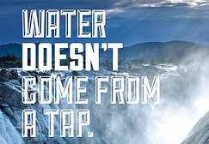


THANK YOU!

